Slide 1

THAT’S NOT MY RJ45 JACK!
IRL NETWORKING FOR HUMANS, Pt. 1
J0hnny Xmas | @j0hnnyXm4s

Slide 2
Ye Olde Disclaimer
I acknowledge that even I am not great at some of the topics I will cover here.
You will need to find what works for you, and identify / fix what doesn’t.
Life decisions you’ve already made may interfere with your ability to execute on some of this.
Society is woven around inconvenient truths. This will make you angry. Your anger does not change these truths.

Slide 3
Why Are We Here?
Networking is an organic process. We are organisms.
Being a SOURCE for talent recommendations also makes you useful / cool / desirable as a friend
Not just learning to be a sycophant; we’re not trying to collect a bunch of Pokemon to ignore until we need them
Notes:
This is not just about getting a job or promotion; It’s about making your current job easier by bettering your relationship with coworkers, especially on other teams. Its is all about making people like you.

Slide 4
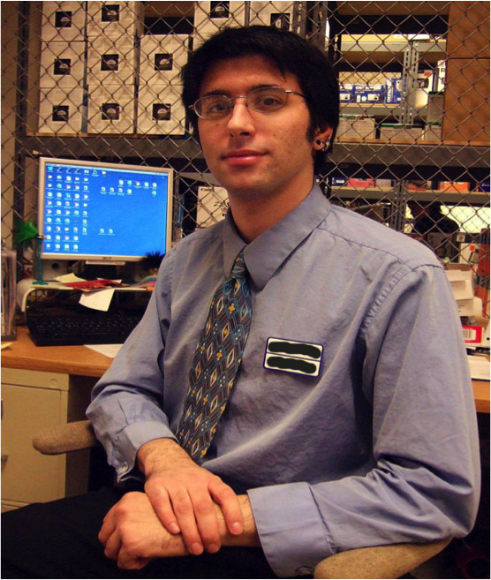
Street Cred!
Notes:
Agoraphobic
Adult acne
Greasy hair
Severe scoliosis
Clothes don’t fit me

Slide 5
Street Cred!
Got my first for-realz IT job through a friend I made while working retail
Landed a base InfoSec engineer role with a GLOBAL 1000 co. via a friend I made while playing board games
Promoted to Senior within 18 months with no prior experience
Promising career Red Teaming as a Sr. Consultant via a friend I’ve only seen 5 times

Slide 6
Street Cred!
PRETTY LUCKY, RIGHT?!

Slide 7
I LEARNED
TO PLAY
THE GAME.
Notes:
The game of getting people to like & remember you.

Slide 8
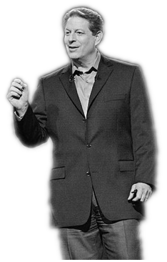
INCONVENIENT TRUTH #1:
The Game is Real Whether You
Like It or Not.

Slide 9
INCONVENIENT TRUTH #1:
The Game is Real
Granpda’s method of “If you work hard, you’ll run the company one day” is old and wrong.
Your only choice is to play, or sit back and watch us play it.
The only way to win is to play.
The WORST pro sports players make more than any of us
At least show up. Even a participation trophy is better than nothing
Notes:
You may not end up being the President or a CIO, but you’re gonna end up way better than the person working as a Jr. Analyst when they’re 60.
More on showing up later

Slide 10

AVERAGE.

Slide 11
OMG MATH IRL
The more places you show up to, the greater your chances of being in the right place at the right time. Period.
Notes:
NETWORKING IS A GAME OF STATISTICS
“Showing up is 80% of life” – W. Allen
Showing up means a lot of things. In the literal, it means just going to where you should be going, instead of staying home in bed. You’re not going to meet that person who’s going to be useful to you by sitting on the couch. Random strangers don’t happen to pass by your bed. At least, not the useful ones.

Slide 12
THIS IS HOW YOU GET
THAT PARTICIPATION TROHPY
THIS IS HOW YOU SHOW UP
Notes:
THIS IS WHAT WE’RE TALKING ABOUT TODAY
I make it sound easy, right>?

Slide 13
INCONVENIENT TRUTH #2:
“Showing Up”
is Actually
Really Hard

Slide 14
INCONVENIENT TRUTH #2
Showing up is hard.
“It is so much easier not to do things than to do them, that you would do anything at all is totally remarkable.
In terms of instant relief, cancelling plans is like heroin.
If you ever ask an adult what they did over the weekend, and they say they didn’t do anything, Their faces LIGHT UP.”
John Mullaney
Notes:
GREAT SO HOW DO I MAKE MYSELF DO IT?

Slide 15
How to Show Up:
DO IT.
GO.
Srsly.
SAY YES TO EVERYTHING.

Slide 16
This Sounds like Work
IT IS. Treat it with the responsibility of a job.
It’s also a skill.
You must practice in order to master it
You must consciously think about each step and keep a log (mental or otherwise) of what’s going on
Over time, it will become a natural part of your toolset.
YOU MUST KEEP A SOCIAL CALENDAR.
Notes:
REQUIRED READING OR END OF ACT I

Slide 17
I Am A Failure.
FAILURE IS THE ONLY WAY WE LEARN.
Review, adjust, re-test.
You’re not going to click with everyone.
Especially on first impressions.
A 20% (1 in 5) success rate is considered masterful.
Regardless of this, DO NOT BURN BRIDGES.
EVER.

Slide 18

REQUIRED READING

Slide 19
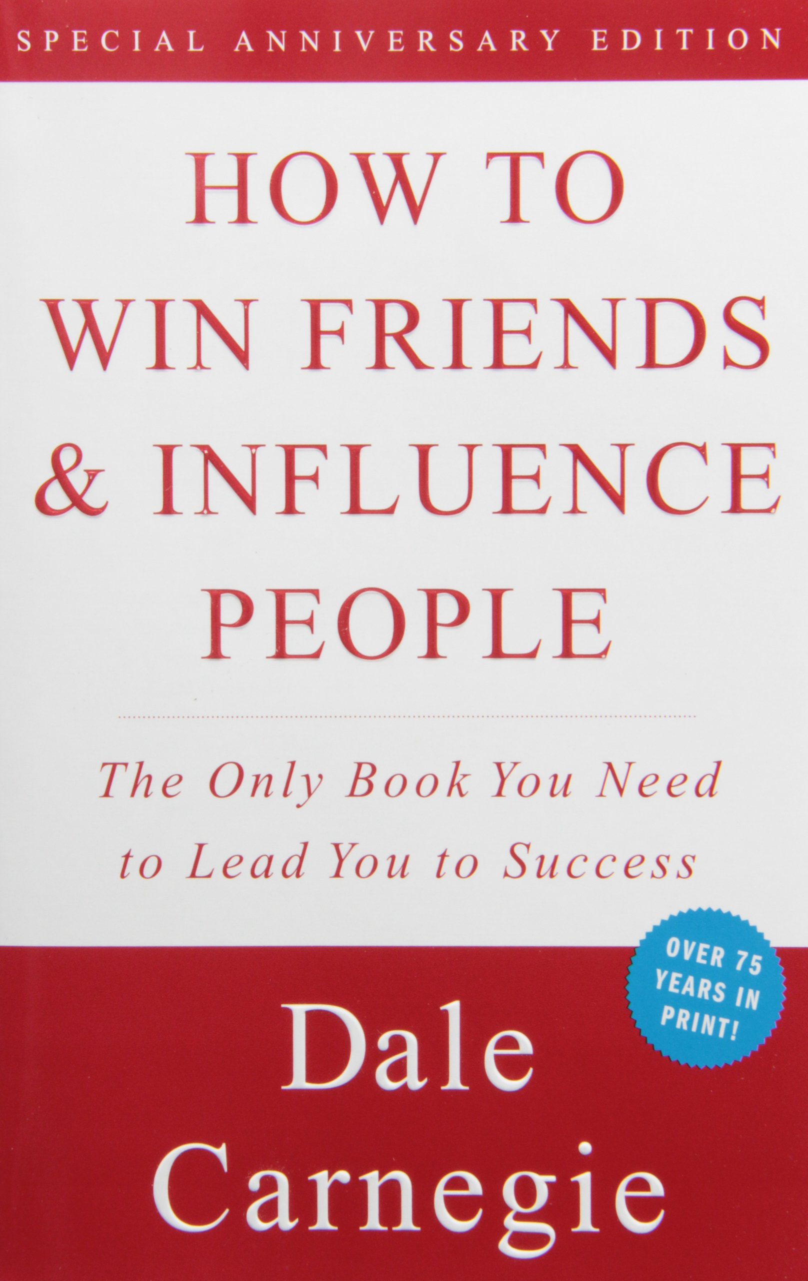
REQUIRED READING

Slide 20

REQUIRED READING

Slide 21

REQUIRED READING

Slide 22
End of Act 1
Johnny Xmas | @j0hnnyXm4s | https://github.com/johnnyxmas

